Slide 1
Optuna Training
Adam Kotter
10-17-22

Slide 2
Hyperparameter Optimization
Parameters of how to run the training algorithm
Right hyperparameters make or break algorithm performance

Slide 3
Optuna
https://youtu.be/P6NwZVl8ttc?t=270
4:30 - 11:23
Pay attention to:
Why Optuna?
Basic Optuna strategy
Pruning
Sampling

Slide 4
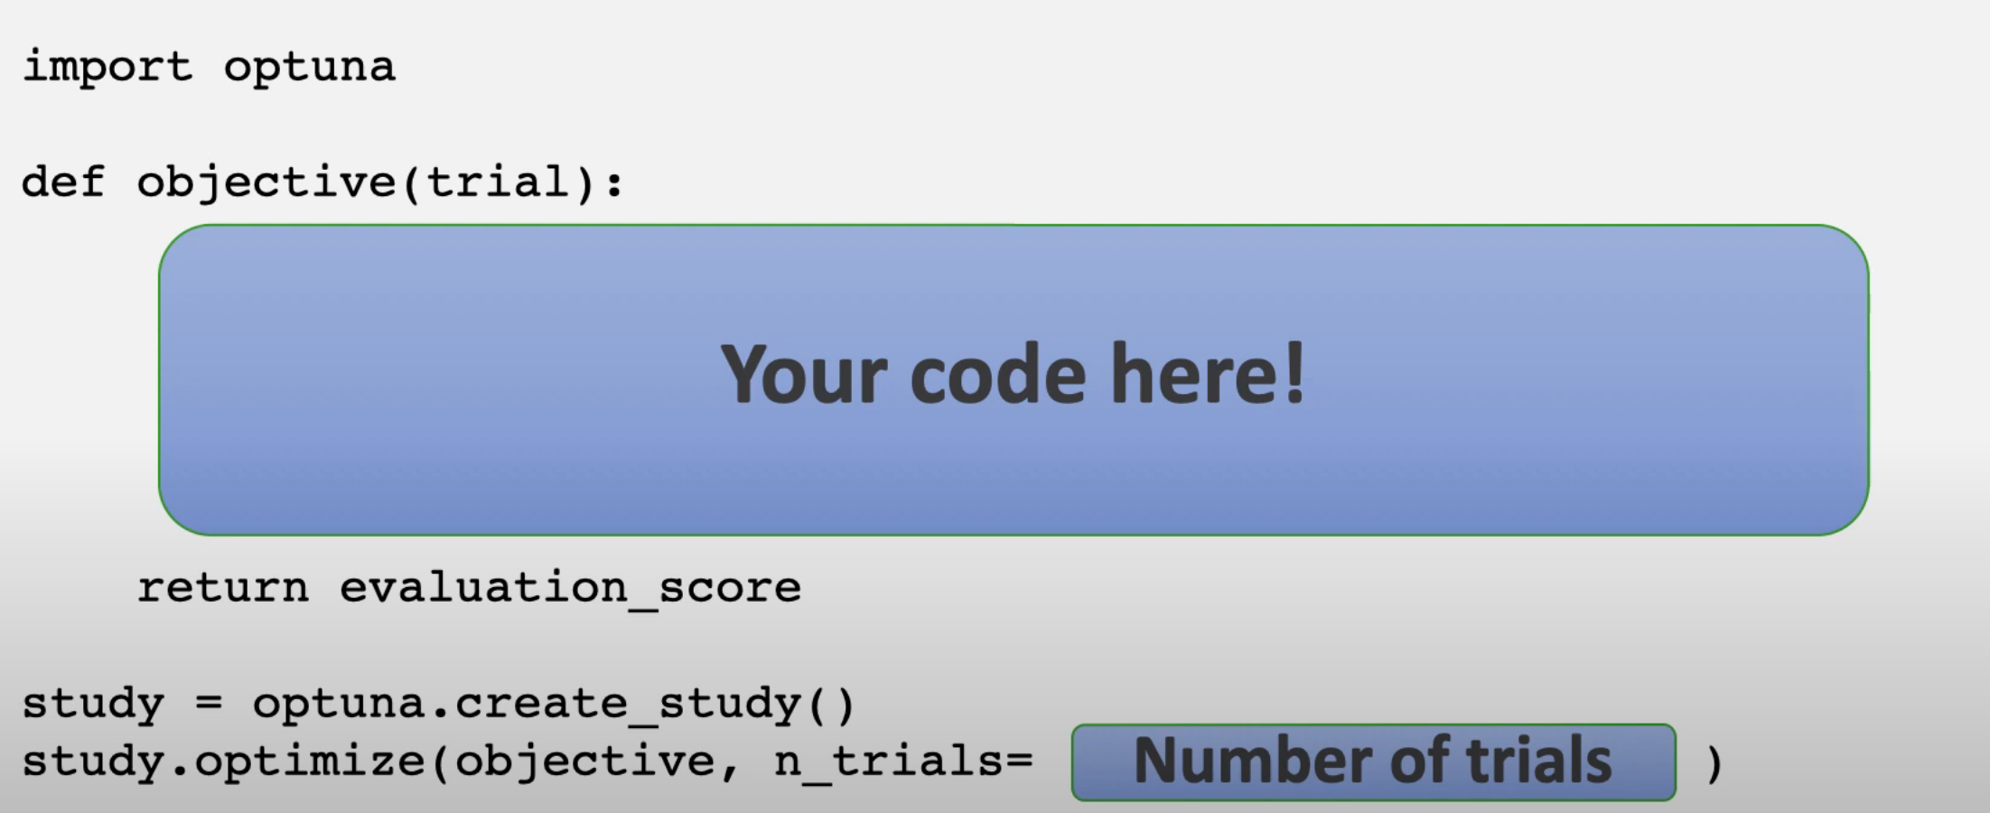
Basic Syntax

Slide 5
Example

Slide 6
References
https://optuna.readthedocs.io/en/stable/tutorial/index.html
https://github.com/optuna/optuna-examples/blob/main/sklearn/sklearn_simple.py

